Slide 1

PREDICTIVE E-SPORTS GAME ANALYSIS USING MACHINE LEARNING APPROACHES
Department of Computer Engineering
Atakan TUZCU
Supervisor:
Dr. Okan BURSA
İzmir University of Bakırçay
Notes:
Introduce yourself, education and professional experience.

Slide 2
Outline
Department of Computer Engineering
Introduction
Collecting Data
Modelling
Evaluation
Experiments
Conclusion
İzmir University of Bakırçay

Slide 3
Introduction
Department of Computer Engineering
İzmir University of Bakırçay
Notes:
Express appreciation for Okan Bursa and Deniz Kılınç.

Slide 4


Sport Analytics
Department of Computer Engineering
Sport analytics have made a huge impact on the field and the book based on true story named “Moneyball” showed with a story that the game analytics make a team bop to the top from the deespest bottom for the baseball games.
İzmir University of Bakırçay
Notes:
Ask the jury members if they read/watch the movie or book. If not, shortly summarize it.

Slide 5
Electronic Sports (aka: e-Sports)
Department of Computer Engineering
E-Sports are the challanging video games can be played usually multiple players. Worldwide tournaments can be held annualy for such games. Nowadays e-Sports tournaments are the new generation of gaming emerge. Counter Strike: Global Offensive, League of Legends, Heartstone, Warcraft, Mobile Legends: Bang Bang are the examples of the.
İzmir University of Bakırçay
Notes:
Ask the jury members if they played any video games.

Slide 6
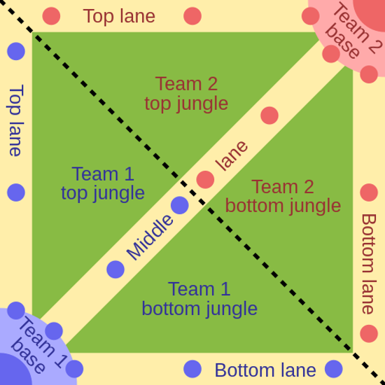
League of Legends
Department of Computer Engineering
League of Legends is the one of the most popular multiplayer online battle arena games in the e-Sports field which is developed and provided by RIOT Games
The nature of the game-play, a League of Legends match ends with a victory of one of the two teams.
İzmir University of Bakırçay
Notes:
If the jury members have not play LoL, shortly summarize the gameplay of a LoL match.

Slide 7
Problem Definition
Department of Computer Engineering
By the nature of the gameplay, as in most MOBA games, League of Legends ends with one team’s victory and the other team’s defeat, there’s no draw status for this game.
Each action performed during the game effects the game result, as these actions dynamically change the attributes of the match data.
These nature make the League of Legends game, perfect application instance for multivariate statistical analysis building a binary classification problem.
İzmir University of Bakırçay

Slide 8
Purpose and Contribution
Department of Computer Engineering
In this research, a deep analysis over the game data and experimental studies has been done. To provide this task, we have retrieved the data and give it a structure to analyze.
As the results of this thesis, we get a brand new data-set that other researchers can use, preprocessing stages have been operated which future researches can use this methodology to create their datasets, data retrieving tool is being shared, and at last exploratory data analysis have been operated to find importance of strategies.
İzmir University of Bakırçay

Slide 9
Methodology
Department of Computer Engineering
Collecting Data
Modelling
Evaluation
İzmir University of Bakırçay
Notes:
Shortly summarize the process and add the experiments part.

Slide 10
Collecting Data
Department of Computer Engineering
İzmir University of Bakırçay
Notes:
Tell why we need the data? What is the data about and what should be the target.

Slide 11
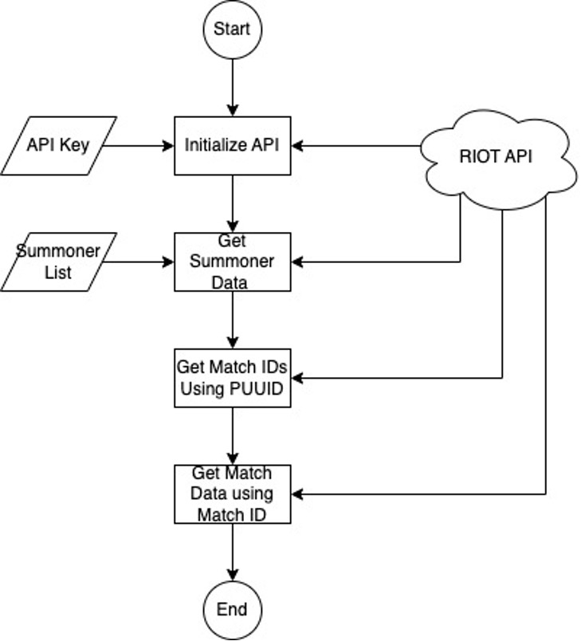
Data Retrieving
Department of Computer Engineering
İzmir University of Bakırçay
Notes:
Tell about the RIOT API and the APIs in it that is being used in this thesis.

Slide 12
Data Preprocessing
Department of Computer Engineering
The longest part of this research was the data preprocessing stage because RIOT API provides data as deeply nested structure. To operate predictive analysis, we need to flatten the data.
Raw data came with too many attributes, and we had feature engineering over the attributes and reduce the attributes to 47.
At final, we operate standard preprocessing techniques to clean the data and group it as teams to have two different approaches: player-based dataset and team-based dataset.
We save the raw data and processed data as CSV after operations.
İzmir University of Bakırçay

Slide 13
Modelling
Department of Computer Engineering
İzmir University of Bakırçay

Slide 14
Machine Learning Approaches
Department of Computer Engineering
Logistic Regression
Naïve Bayes Classifier
Decision Tree
Random Forest
Gradient Boosting
AdaBoost
LightGBM
İzmir University of Bakırçay

Slide 15
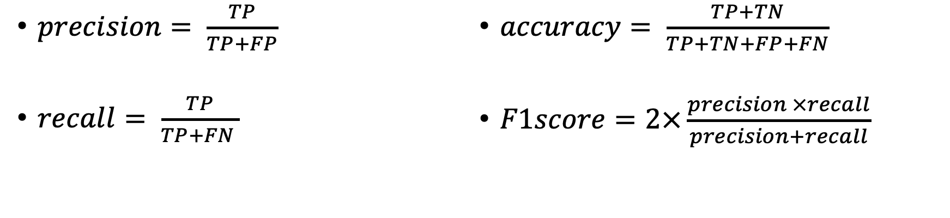
Models Evaluation Metrics
Department of Computer Engineering
Confusion Matrix
 |  | Predicted Classes
 |  | Positive | Negative
Actual Classes | Positive | TP | FN
 | Negative | FP | TN
$precision= \frac{TP}{TP+FP}$
$recall= \frac{TP}{TP+FN }$
$accuracy= \frac{TP+TN}{TP+TN+FP+FN}$
$F1score=2×\frac{precision ×recall}{precision+recall}$
İzmir University of Bakırçay

Slide 16
Evaluation
Department of Computer Engineering
İzmir University of Bakırçay

Slide 17
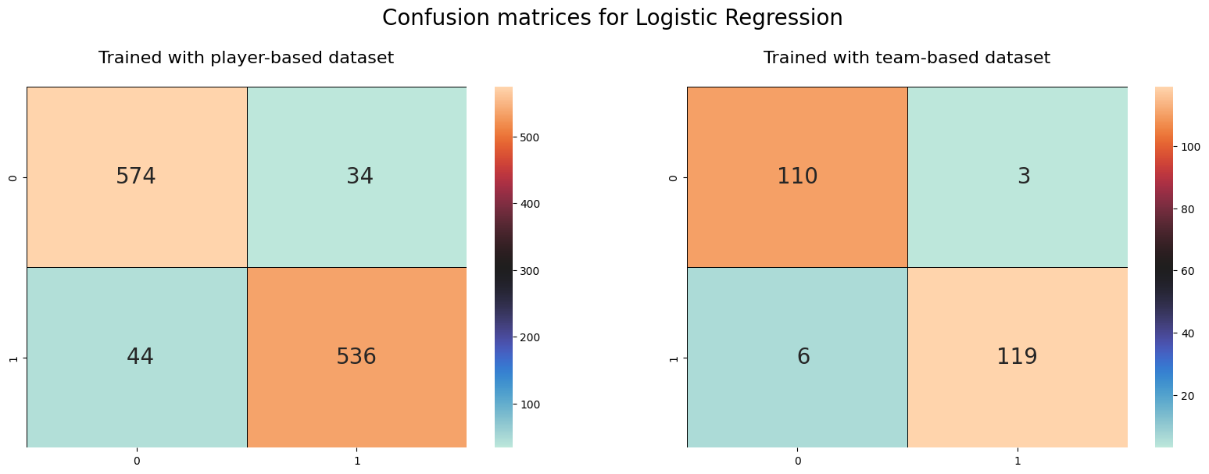
Results of Logistic Regression
Department of Computer Engineering
İzmir University of Bakırçay

Slide 18
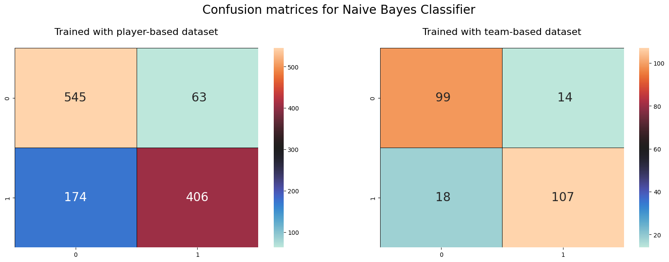
Results of Naïve Bayes Classifier
Department of Computer Engineering
İzmir University of Bakırçay

Slide 19
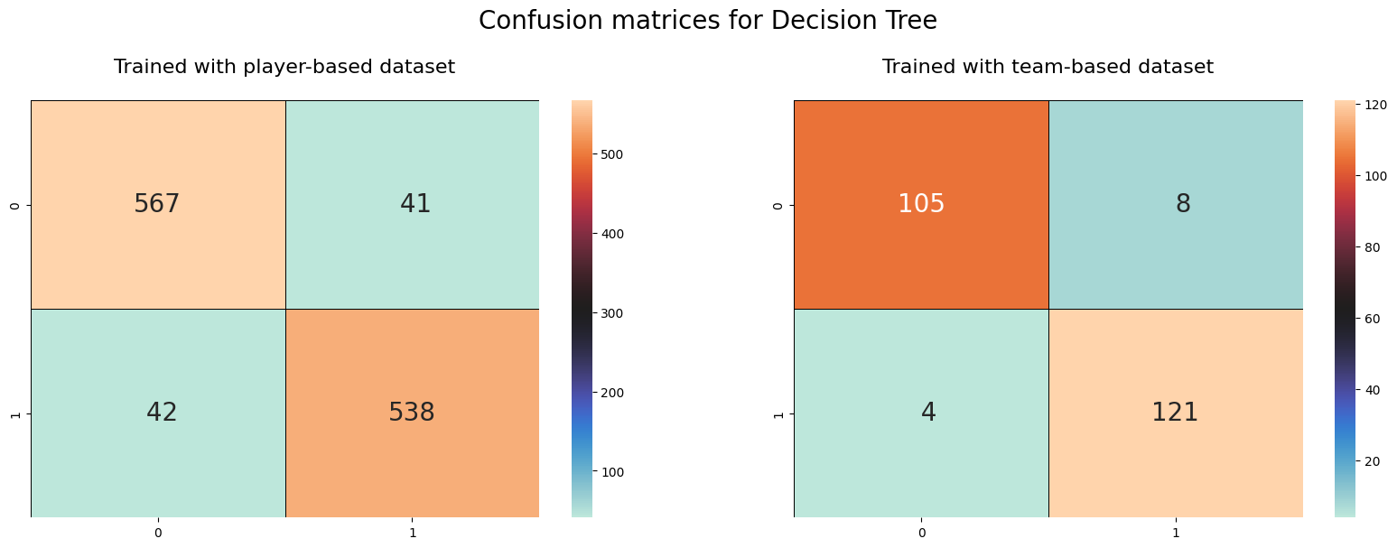
Results of Decision Tree
Department of Computer Engineering
İzmir University of Bakırçay

Slide 20
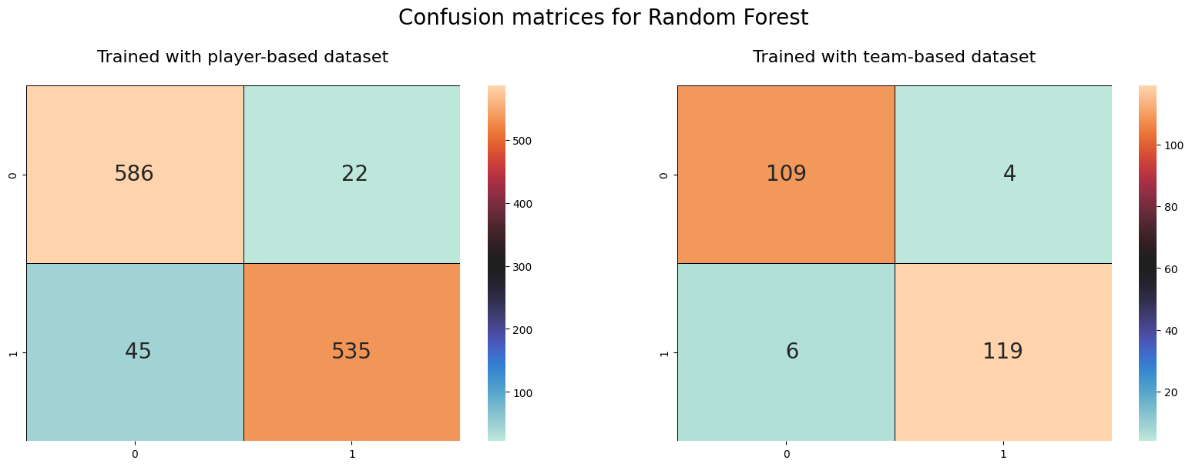
Results of Random Forest
Department of Computer Engineering
İzmir University of Bakırçay

Slide 21
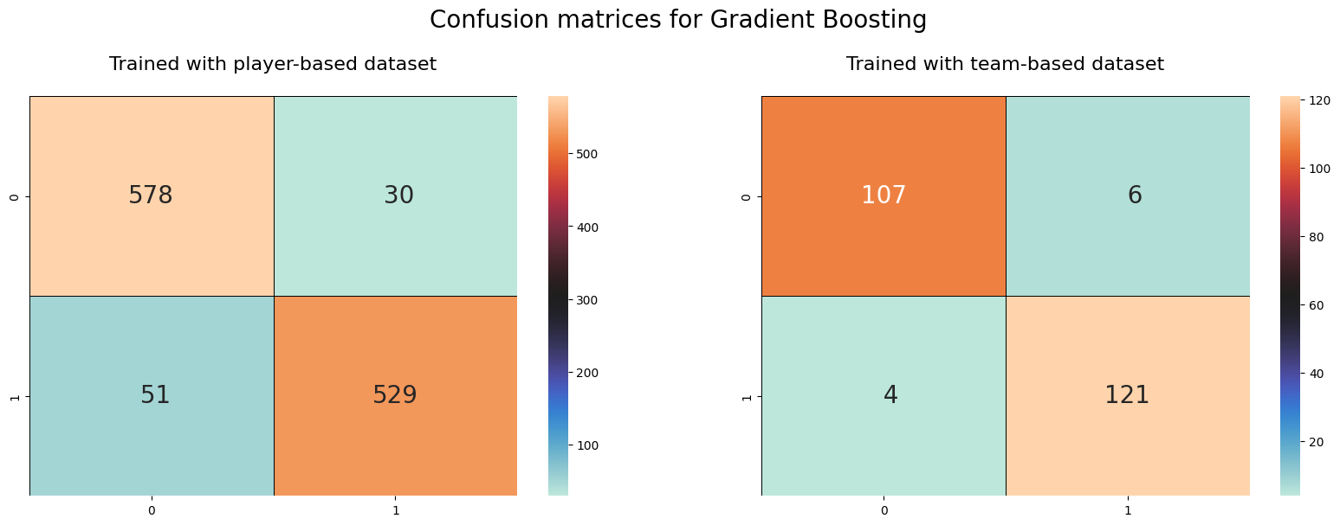
Results of Gradient Boosting
Department of Computer Engineering
İzmir University of Bakırçay

Slide 22
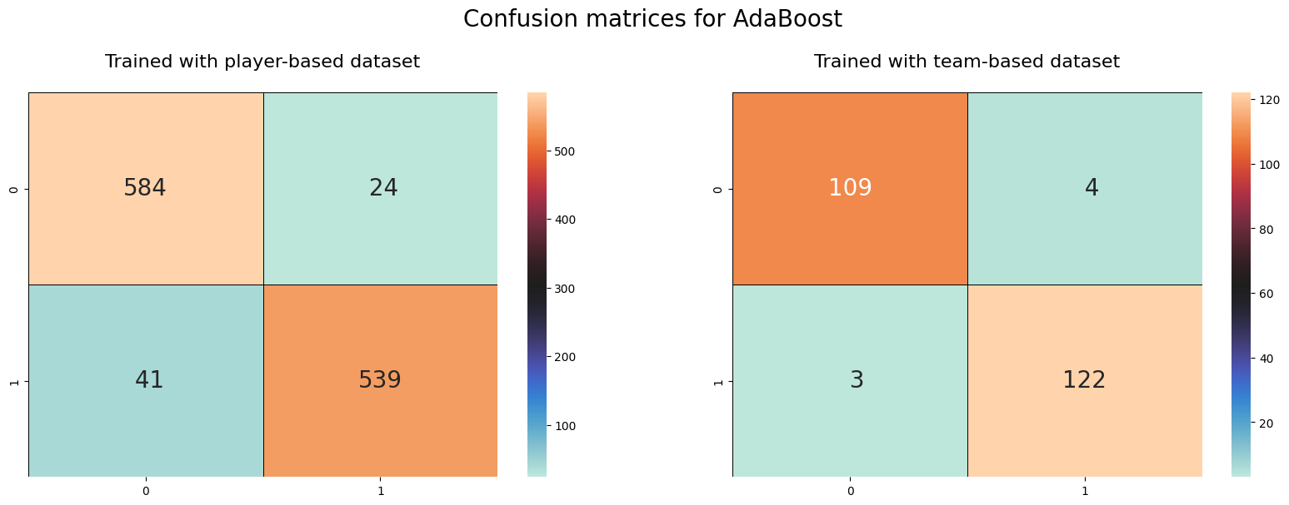
Results of AdaBoost
Department of Computer Engineering
İzmir University of Bakırçay

Slide 23
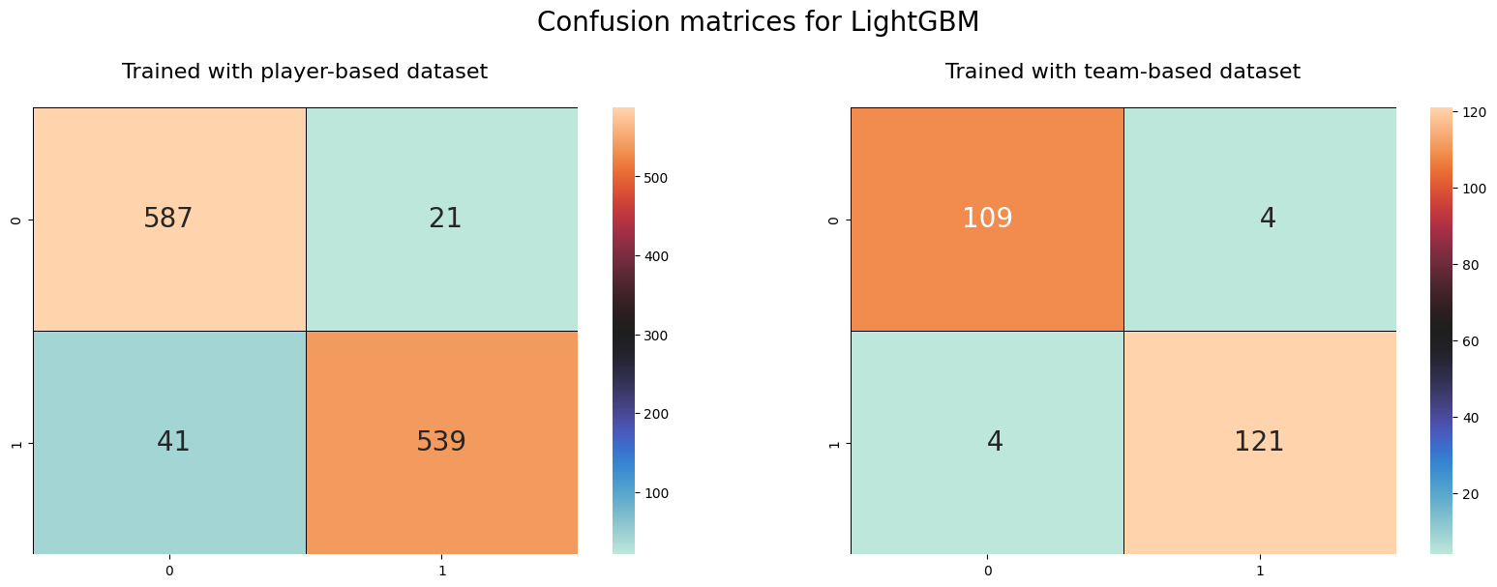
Results of LightGBM
Department of Computer Engineering
İzmir University of Bakırçay

Slide 24
Comparative Metrics
Department of Computer Engineering
MODEL NAME | F1-Scores for Player Based Dataset | F1-Scores for Team Based Dataset
AdaBoost | 0.947 | 0.969
Decision Tree | 0.932 | 0.946
Gradient Boosting | 0.935 | 0.955
LightGBM | 0.950 | 0.965
Logistic Regression | 0.936 | 0.960
Naive Bayes Classifier | 0.821 | 0.861
Random Forest | 0.946 | 0.956
İzmir University of Bakırçay

Slide 25
Experiments
Department of Computer Engineering
İzmir University of Bakırçay

Slide 26
Feature Selection
Department of Computer Engineering
Complexity of a classification or regression model is related to the attributes of input data. Feature selection is a method that is being used to create a subset from a dataset to reduce the dimensions. Using feature selection, the aim is to reduce the running time by creating a simpler dataset.
AdaBoost had the best performance with the highest F1-score on the model training phase, that was the reason we did selected this model’s feature importance.
İzmir University of Bakırçay

Slide 27
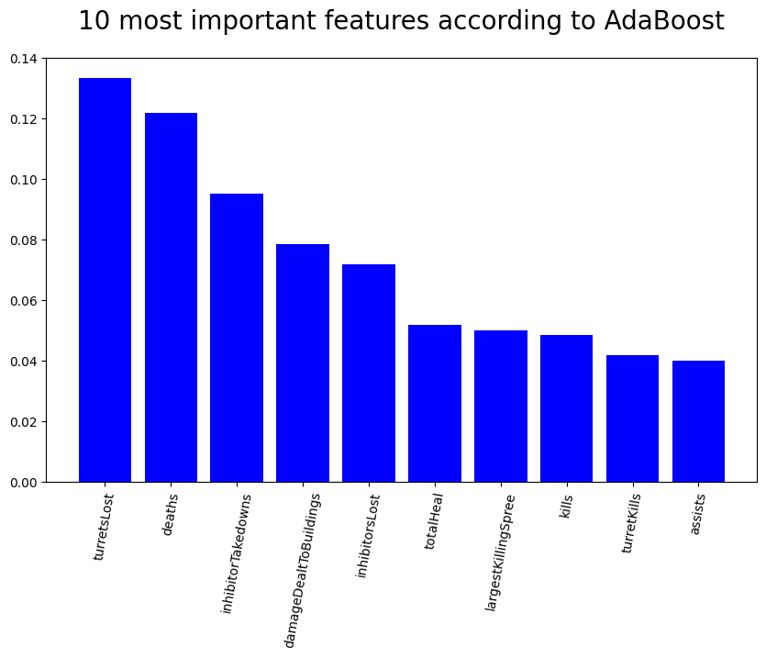
10 Most Important Features
Department of Computer Engineering
İzmir University of Bakırçay

Slide 28
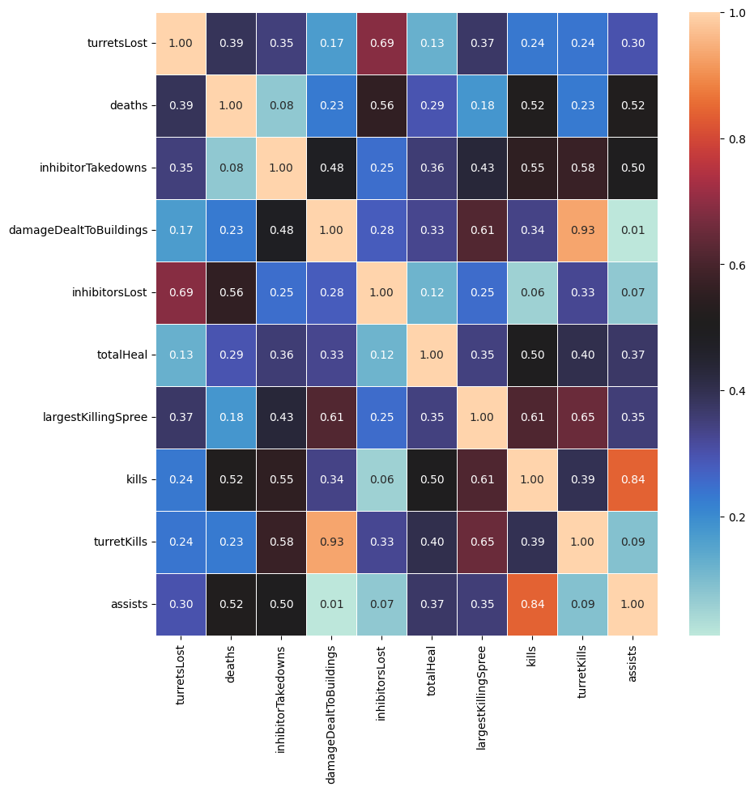
Correlation Between 10 Important Features
Department of Computer Engineering
İzmir University of Bakırçay

Slide 29
Selected Features
Department of Computer Engineering
turretsLost
deaths
inhibitorTakedowns
damageDealtToBuildings
totalHeal
largestKillingSpree
kills
İzmir University of Bakırçay

Slide 30
Comparative Metrics After Feature Selection
Department of Computer Engineering
MODEL NAME | Player Based DataSet |  | Team Based DataSet
 | F1-Scores Without FS | F1-Scores With FS | F1-Scores Without FS | F1-ScoresWith FS
AdaBoost | 0.947 | 0.899 | 0.969 | 0.960
Decision Tree | 0.932 | 0.872 | 0.946 | 0.945
Gradient Boosting | 0.935 | 0.911 | 0.955 | 0.960
LightGBM | 0.950 | 0.950 | 0.965 | 0.965
Logistic Regression | 0.936 | 0.880 | 0.960 | 0.956
Naive Bayes Classifier | 0.821 | 0.851 | 0.861 | 0.898
Random Forest | 0.946 | 0.912 | 0.956 | 0.956
İzmir University of Bakırçay

Slide 31
Conclusion
Department of Computer Engineering
İzmir University of Bakırçay

Slide 32
Summary
Department of Computer Engineering
Data has been retrieved from RIOT API
Two different approach used to build datasets: team-based, player-based
7 machine learning models have been evaluated
Comparison of models have been done using metrics of confusion matrix
Experiments operated using feature selection
7 most important features have been stated out
Results of metrics compared for experiments
İzmir University of Bakırçay

Slide 33
Discussions
Department of Computer Engineering
Output of the AdaBoost model, 7 important attributes have been put forward which are “turretsLost, deaths, inhibitorTakedowns, damageDealtToBuildings, totalHeal, largestKillingSpree, kills” are the key factors for building a strategy in gameplay.
İzmir University of Bakırçay

Slide 34
Future Works
Department of Computer Engineering
Some other machine learning approaches like SVM, or some deep learning models can be applied for the future works. Also, data span can be enlarged as we eliminated many attributes while retrieving the data.
RIOT API provides game data by timeline. As a future work, the problem can be evaluated as time-series analysis and build some LSTM models and compare the performances.
İzmir University of Bakırçay

Slide 35
Thanks for your time. -Atakan TUZCU
Department of Computer Engineering
İzmir University of Bakırçay

